Slide 1
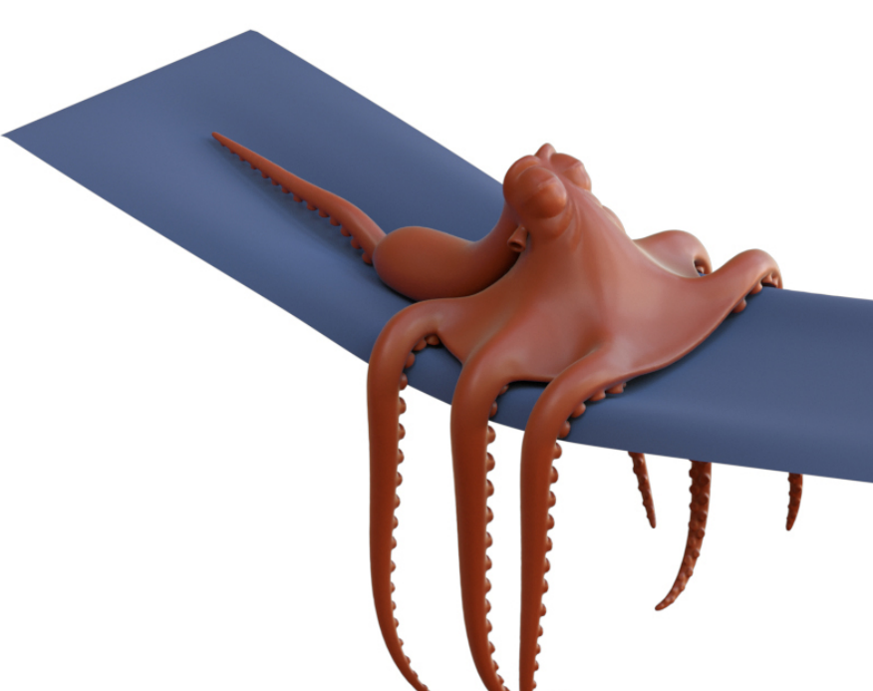
Deformable Simulation
Spatial and Temporal Discretization

Slide 2
Outline today
Integration in time
Explicit
Implicit
Integration in space
Mass-Spring system
The finite element method

Slide 3
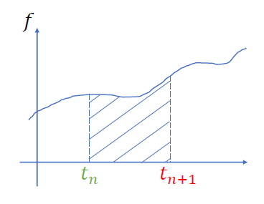



Equations of motion (general cases)
$$M\ddot{x}=f(x)$$
$$\dot{x}=v \dot{v}=a=M^{−1}f$$
$$x\left(t_{n}+h\right)=x\left(t_{n}\right)+\int_{0}^{h}{v\left(t_{n}+t\right)dt}$$
$$v\left(t_{n}+h\right)=v\left(t_{n}\right)+\int_{0}^{h}{M^{−1}f\left(t_{n}+t\right)dt}$$
$h=t_{n+1}−t_{n}$ is the time-step size
We don’t know how to integrate this quantity
We don’t know anything after $t_{n}$

Slide 4

Time integration (Explicit)
$$x_{n+1}=x\left(t_{n}\right)+\int_{0}^{h}{v\left(t_{n}+t\right)dt}≈x_{n}+hv_{n}$$
$$v_{n+1}=v\left(t_{n}\right)+\int_{0}^{h}{M^{−1}f\left(t_{n}+t\right)dt}=v_{n}+hM^{−1}f(x_{n})$$
Accuracy: 1-st order accurate
$$\int_{0}^{h}{v\left(t_{n}+t\right)dt}=hv\left(t_{n}+0\right)+\frac{h^{2}}{2}v^{′}\left(t_{n}+0\right)+…$$
$=hv_{n}+O(h^{2})$

Slide 5
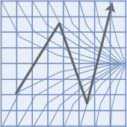
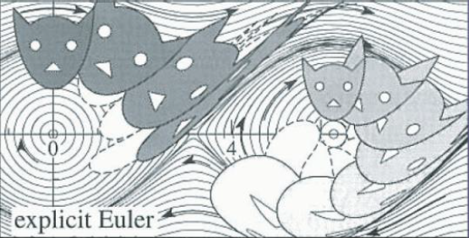

Time integration (Explicit)
Stability:
$\frac{d}{dt}x=λx$
$x_{n+1}=x_{n}+hλx_{n}$
$x_{n}={\left(1+hλ\right)}^{n}x_{0}$
Condition of stability:
$\left|1+hλ\right|≤1, h≤\frac{2}{\left|λ\right|}$
Explicit Euler is extremely fast, but it will also increase the system energy gradually. Not recommended in almost all situations.

Slide 6

Time integration (Implicit)
$$x_{n+1}=x\left(t_{n}\right)+\int_{0}^{h}{v\left(t_{n}+t\right)dt}≈x_{n}+hv_{n+1}$$
$$v_{n+1}=v\left(t_{n}\right)+\int_{0}^{h}{M^{−1}f\left(t_{n}+t\right)dt}v_{n}+hM^{−1}f(x_{n+1})$$
Accuracy: 1-st order accurate
$$\int_{0}^{h}{v\left(t_{n}+t\right)dt}=hv\left(t_{n}+0\right)+\frac{h^{2}}{2}v^{′}\left(t_{n}+0\right)+…$$
$=hv_{n}+O(h^{2})$

